Slide 1
Lecture 13 - Technical Budgets

Slide 2
Two Basic Ways of Working A Problem
The “garage inventor model”
  Conceive a design solution and keep tinkering with it to meet the design requirement after it is built
  No guarantee that you will ever get there
A disciplined engineering approach
  Conceive a design solution
  test it against key performance parameters
  develop budgets for key technical aspects of the design
  evolve the design by making design decisions that meet the key performance parameters and live within the budgets
  May not get there as fast as brilliant intuition of a garage inventor but it will get you there if a solution exists
    Often garage inventors end up developing something different than their original intent
    Disciplined engineering approach will keep you on the original problem

Slide 3
Typical Budgets
Cost to develop
Cost to manufacture
Cost to own and operate
Time To Develop (Schedule)
Time to Produce (Schedule)
Weight
Volume
Number of operators required
Performance – speed, altitude, range, payload capacity, accuracy, stability, maneuverability
  Cars, boats, trains, planes, spaceships
Electrical Power
Consumables – raw materials, fuels, propellants, pressurizing gases, coolant
Data – amount of data to be transmitted, stored, displayed

Slide 4
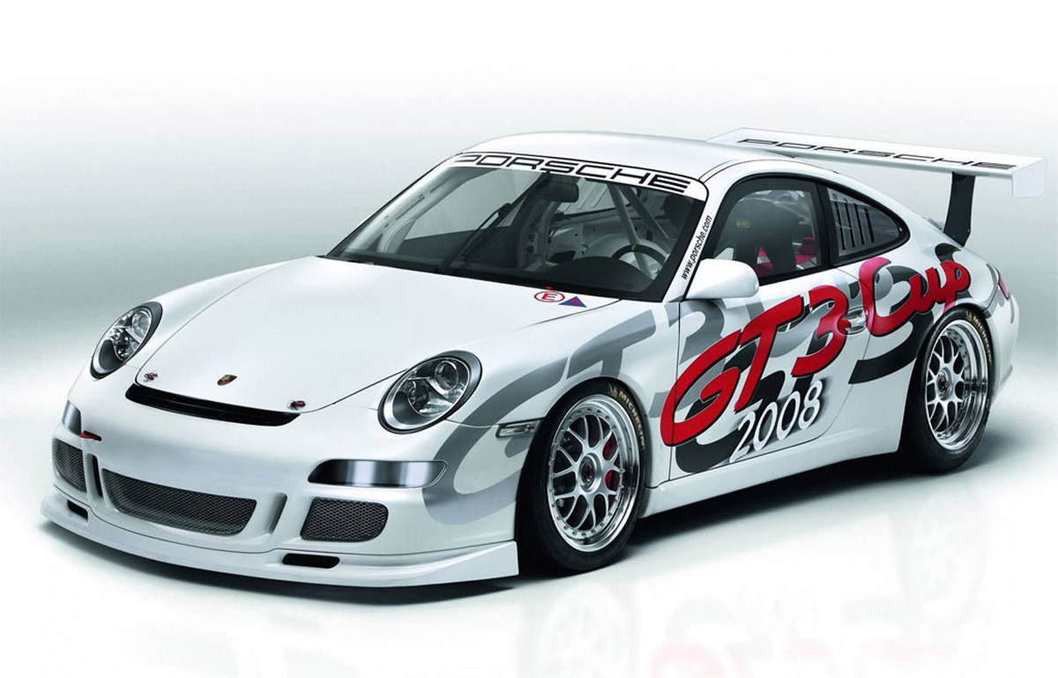
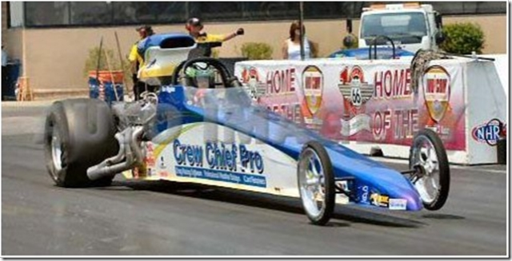
Example – Race Car Design
A drag racing car is being designed.
Drag Racers win races based on their ability to accelerate
Should you build an ultra-lightweight car with small engine
Or a heavier car with a bigger engine ?
How would you evaluate alternatives given a range of possible engines, their structural requirements, and the possible structural materials and configurations ?

Slide 5
Rigorous Approach
Establish a reference design configuration
Evaluate its performance against key performance parameters using an analytical model
  Some parameters are fixed in terms of available technology and existing designs
  Sometimes you can size a system assuming that you can design a part to be optimal for this one design
    That kind of assumption is often called a “rubber design” because you can stretch it as you need to
    Often “rubber engines” are assumed in aircraft design and when the aircraft design is baselined (finalized), the aircraft manufacturers ask the engine manufacturers to build an engine optimized for the specific aircraft
Vary the parameters of the system until you get a good solution
Based on that design establish budgets
  Weight
  Volume (interior)
  Horsepower
  Acceleration
Then perform detailed design and compare the detailed design performance to the budgets

Slide 6
A seductive concept
In every one of the following examples there was a seductive concept
The seductive concept was an idea that was so desirable that people ignored concerns that budget and key performance parameters would not be met
One of the main reasons for keeping budgets and tracking key performance parameters is to keep you from being seduced by an idea.

Slide 7
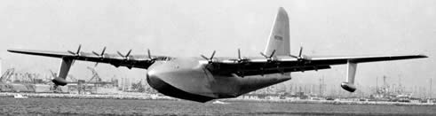
This sounds obvious …
But systems engineering came out of disastrous system developments that occurred during WW2 and the post war era and sometimes still continue today
The Spruce Goose
By far the biggest airplane ever built, the H-4, also known as the Hercules, had a wingspan of 320 feet--20 feet longer than a football field. It had enough cargo space to carry two railroad boxcars. It had eight massive engines with 17-foot propellers. It weighed 300,000 pounds. And it was made of wood
It only ever flew once at low altitude for about a mile….
From www.straightdope.com
The seductive concept – Ships were being sunk by German submarines in the Atlantic. Airplanes this big could replace large cargo ships for supplying the European war effort.
Key performance budgets ignored – climb rate, range, endurance

Slide 8
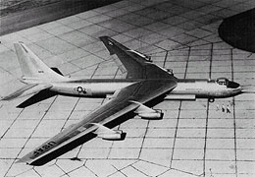
Another example
Nuclear powered airplane pursued in the 1950’s
Prototype built – idea was unending flight
Never practical – nuclear reactors are nowhere near the efficiency of aircraft power plants and the shielding weight is prohibitive
Thrust/weight ratio using heated air can never approach the thrust /weight ratio required for aircraft powerplants
Seductive concept – an aircraft that could fly unrefueled for weeks. At the time US nuclear armed bombers were kept in the air 24 hrs/day to prevent them being caught on the ground in a surprise attack. This required an extensive system of inflight tankers and alternate bases.
Key Budget ignored – thrust/weight ratio

Slide 9
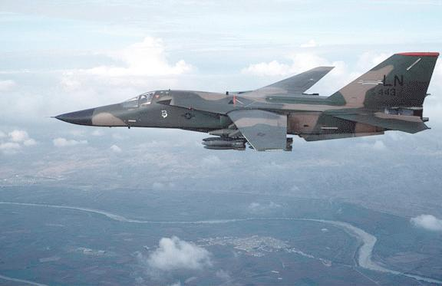
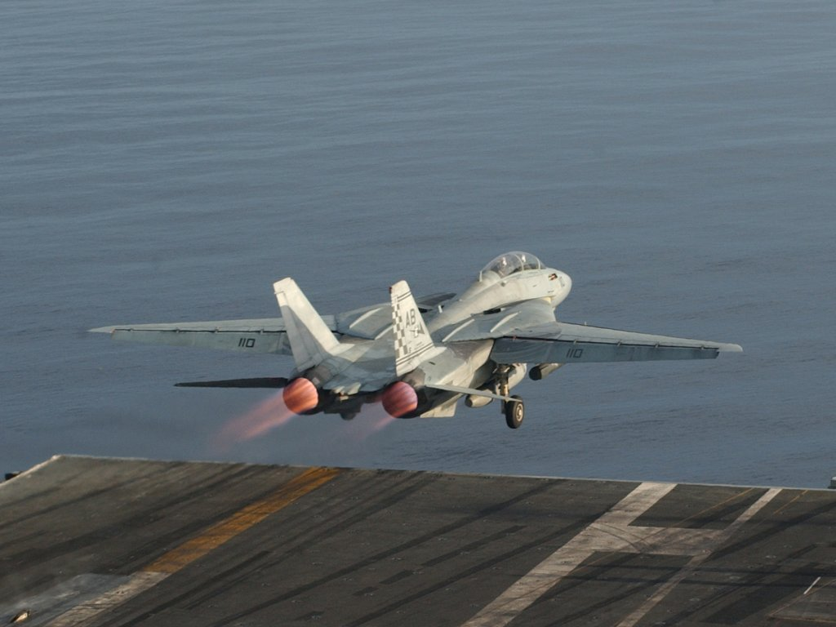
FB-111 vs F-14
F111- Designed as a common Air Force and Navy fighter
Swing wing afforded greater maneuverability but weight penalty of mechanism in initial implementation left the vehicle severely underpowered and too heavy for carrier operations
Never succeeded as a fighter, ended its career as a bomber in Air Force service.
F-14 Tomcat, using the same idea became one of the most successful fighters of all time
Seductive concept – a single aircraft that could meet all services needs
Key Budget ignored – weight, Takeoff and Landing Performance
F-111
F-14

Slide 10
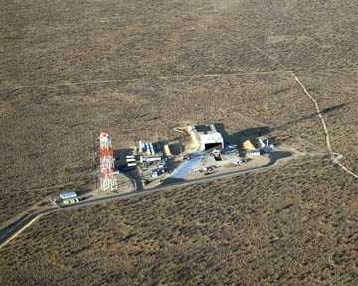
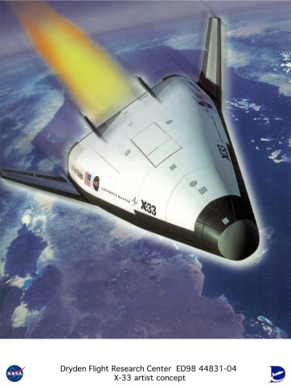
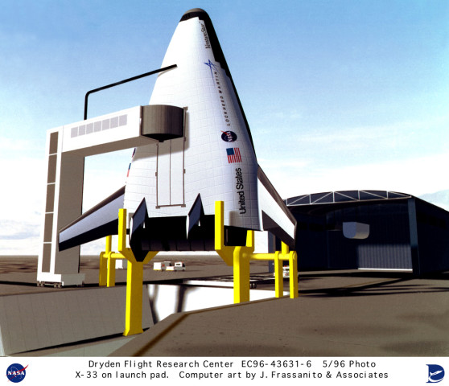
A more modern example – 2000-2005
X-33 single stage to orbit demonstrator
With advanced propulsion technology, it still would have required greater structural efficiency than that of a soda can to meet its speed and altitude targets without cargo
Over $250M spent, much advanced technology developed, but nowhere near an operational system
  Performance budget at the time of cancellation showed that the best the vehicle could have done was Mach 5 versus Mach 25 design
Seductive concept – a spacecraft that was completely reusable and therefore 1/10 of the cost to operate as other launchers
Key budgets ignored – weight, launch performance
Completed X-33 Launch Complex

Slide 11
Critical Design Questions
What does our design need to do ?
How is it intended to work ?
For it to work, what conditions must be met ?
What calculations do we have that show the conditions are being met ?
What margin is available to deal with unanticipated requirements ?

Slide 12
Margin
Margin is the term used to describe the excess capacity in any part of a design versus the budget or requirement
  In aircraft structural design, a factor of 20% weight growth is anticipated between preliminary design and final implementation due to unanticipated requirements.
  Therefore a 20% unallocated margin or reserve must be held versus the weight budget at the PDR point
Margin is used up through the process and an efficient design has near zero margin when finally implemented
Margin can be allocated to components of a design or be unallocated reserve
  More mature components need less margin
When a design can meet all of its performance goals with all elements within identified budgets, then the design is said to “close”
When a design can’t be made to close, it is usually the start of a disaster
  It becomes harder and harder to make a design close

Slide 13
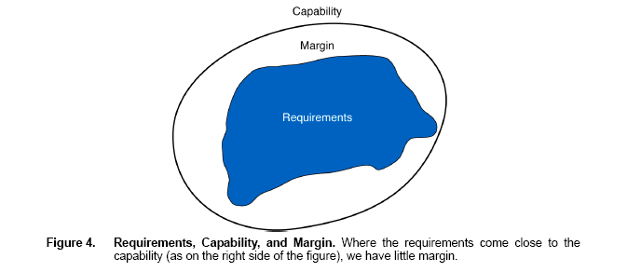
Requirements
Include
Factor of safety
From: The Art and Science of Systems Engineering by Michael Ryschkewitsch, Dawn Schaible and Wiley Larson, Jan 2009
Notes:
This diagram shows the difference between requirements, capability and margin. A requirement states what a design must do to accomplish its function. This normally includes a factor safety to account for unknown or dispersed conditions. The capability is what the design is capable of doing. The difference between capability and requirement is called margin.

Slide 14
To understand the idea of a design that won’t close…
Look at the problem of a perpetual motion machine
No matter how clever you get, you can’t break the 2nd law of thermodynamics
Doesn’t stop uninformed people from trying
When you look at the designs mathematically, you can always show that the design doesn’t close
  Energy has to be introduced into the system for motion to occur

Slide 15
Budgets Exercise
To understand the idea of technical budgets we are going to do an exercise
This exercise is often used to show how teams can make better decisions that individuals, but we are going to use it to get practice at making and managing to technical budgets
Scenario
  You are the member of a space crew originally scheduled o rendezvous with a mother ship on the lighted surface of the moon.
  Due to mechanical difficulties your ship was forced to land a spot 30 miles from the rendezvous point
  During landing, much of the equipment was damaged
  Since survival depends on reaching the mother ship, the most critical items must be chosen for the 30 mile trip
  Assume each member of the crew can carry 50 lbs and travel 1 mile per hour. 8 hours of rest are needed every 24 due to the effort exerted in walking in the pressurized suits.
  From the available materials, build a weight budget for each persons load, considering the needs to breathe, eat, hydrate, rest, navigate and communicate.
  See the problem sheets

Slide 16
Input data for budget exercise
Item | weight | power consumption | other critical characteristic
Box of matches | 5 oz | 0 | 12 matches
Food concentrate | 4 lbs | 0 | nutrition for 28 days for a single person
50 ft of nylon rope | 1 lb | 0
Parachute Silk | 30 lbs | 0
Portable Heating Unit | 40 lbs | 2 amps
Two .45 caliber pistols | 10 lbs | 0
Flare Gun modified for vacuum use | 5 lbs | 0
One Case of dehydrated milk | 8 lbs | 0
Two Bottles of Oxygen | 100 lbs | 0 | High pressure - enough for 1 person for 8 days
Stellar Map | 5 oz | 0
Self Inflating Life Raft | 20 lbs | 0
Magnetic Compass | 8 oz | 0
5 gallons of water | ? | 0 | density = 62.4 lb/cu ft and 7.481 gallons/cu ft. Human need is for 2 quarts/day in survival situation
first aid kit with modifications for in suit use | 2 lbs | 0
survival radio - fm receiver/transmitter | 5 lbs | 1 amp
25 batteries | 20 lbs | 1 amp-hr per battery | batteries can be separated into individual batteries
Notes:
This is the input data for the technical budgets exercise.

Slide 17
My Solution
Oxygen is the limiting consumable – carry all you can – it gives you 2 days
At 1 mph with 1 rest breaks we should be able to cover 32 miles – with 10 hrs of margin
  Margin shrinks to 2 hrs if we have an unscheduled 8 hr rest break
Food – break down to only carry 2 days worth
  2 days times 4 people = 8 person- days = approx 8/28*4 lbs = 1.1.5 lbs
Water – have to carry in gallon sized containers
  Need 8 people days – require 2 quarts per person-day = 8*.5 gallons = 4 gallons which weigh 4*62.4 lbs/cu ft/7.48 gallon –cu ft = 43 lbs
Shelter – carry parachute silk and rope
Communications – assume able to talk for 15 mins every hour to coordinate rescue – that means 12 hrs of operation of the radio or 12 batteries *20 lbs/25 batteries = 9.6 lbs

Slide 18
My Solution
Team Member 1 – carries 02 tank #1 – 50 lbs
Team Member 2 – carries 02 tank #2 – 50 lbs
Team Member 3 – carries food, water and flare gun – 50 lbs
Team member 4 carries stellar map, radio and batteries and nylon rope and parachute silk – 45.6 lbs

Slide 19
Weight and Center of Gravity
In systems, we have to struggle with both a weight budget and its effects on moments of inertia and center of gravity
The location of the center of gravity of an object with respect to the center of forces (aerodynamic lift, buoyancy, acceleration about a curve) will determine the stability of the object
  Center of gravity – the point at which the entire weight of a body may be considered as concentrated so that if supported at this point, the body would remain in equilibrium in any position
So in addition to asking how much something weighs in a weight budget, we have to ask where the weight is to be located to determine its effect on center of gravity and moments of inertia
The relationship of the center of gravity to other forces in a system often deteremines its stability

Slide 20
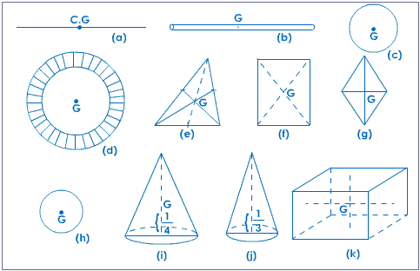
Center of Gravity for solid uniform regular shapes
 | Object | C.G
a. | Uniform straight wire | the mid point
b. | Uniform beam or rod | the mid point of the axis
c. | Circle | the center of the circle
d. | Ring | its center
e. | Triangle | Centroid
f. | rectangle | intersecton of its diagonals
g. | rhombus | intersecton of its diagonals
h. | Sphere | its center
i. | Solid cone | 1/4th of its height from its base
j. | hollow cone | 1/3rd of its height from its base
k. | cube/cuboid | the mid point of the line joining the centers of opposite sides
C.G. of solids of different regular shapes
The centre of gravity of some objects are given below in table
From wwww.tutorvista.com
Notes:
Here are some simple relationships for determining the center of gravity for solid uniform regular shap[es. This assumes a uniform density of material, such as machining a shape out of metal.

Slide 21
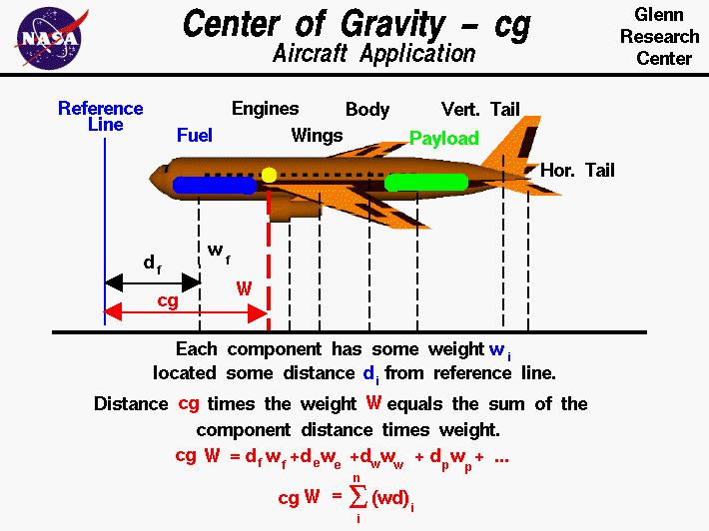
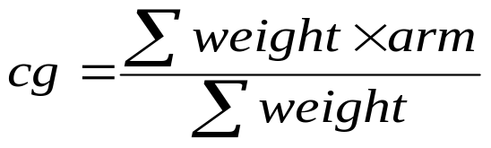
Notes:
These are the equations for determining the center of gravity of an aircraft. The center of gravity is usually referenced to a reference line or datum, which is usually in front of the nose of the aircraft. The term “arm” refers to the location of a weight with respect to the datum. Where there are many separable components (such as the tail) the cg of each of these items can be measured or computed and then all of the weight for that component can be assumed to be at the cg location of that component. The total cg of the aircraft is computed by dividing the sum of the products of individual components masses and their arms by the sum of the weights.
An aircraft is stable if the center of gravity is ahead of the center of pressure of the aircraft, which is where the aerodynamic forces can be represented as a single vector that is independent of aerodynamic condition. It is common for vehicle stability whether boats, planes or cars to be dependent on the location of the cg and its relation to forces.

Slide 22
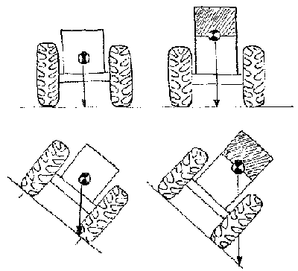
The weight of the crop in the grain-storage tank raises the harvester's center of gravity, the average position of the harvester's weight. Extending the tank height above that recommended by the manufacturer can make the harvester top-heavy and prone to an overturn. If the center of gravity is outside the wheels, the vehicle will overturn. The stability of moving vehicles is more difficult to predict, but keeping the center of gravity low will reduce the chance of an upset.
Notes:
This diagram shows the importance of the location of cg in determining the stability of vehicles. This is from a USDA publication on tractor stability.

Slide 23
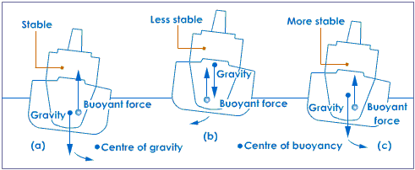
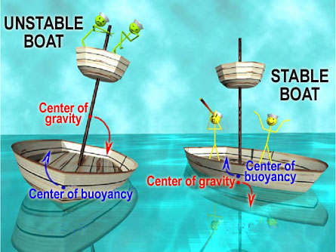
Ship Stability
Notes:
This shows how ship stability is a function of the relationship between the cg and the buoyancy forces,

Slide 24
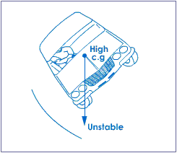
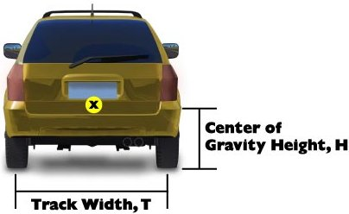
http://www.safercar.gov/portal/site/safercar/menuitem.13dd5c887c7e1358fefe0a2f35a67789/?vgnextoid=4c48e66aeee35110VgnVCM1000002fd17898RCRD
Notes:
This diagram shows how the stability of a car is determined by the relationship between the track width and the height of the center of gravity.

Slide 25
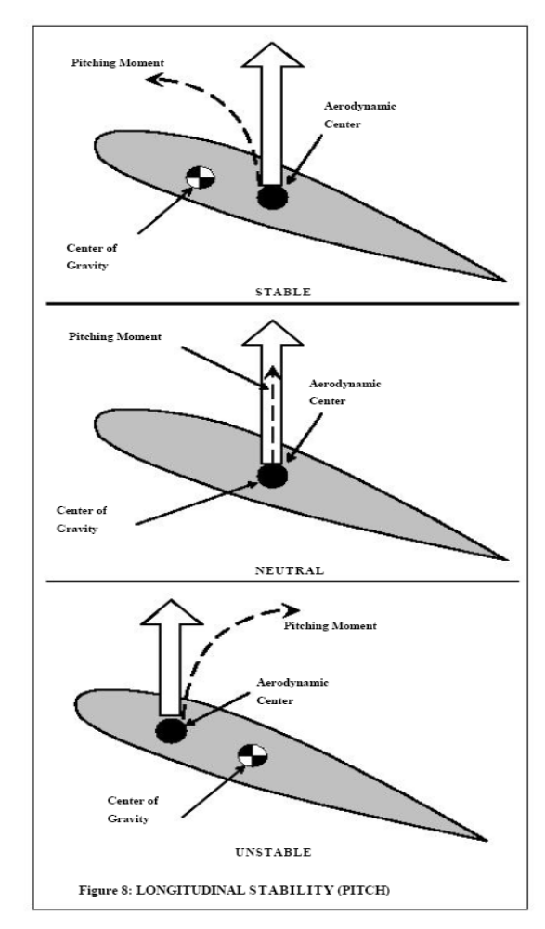
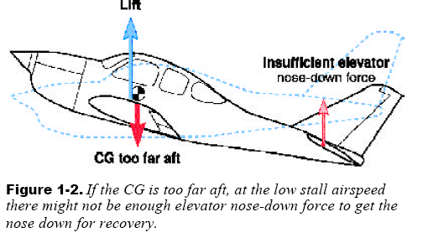
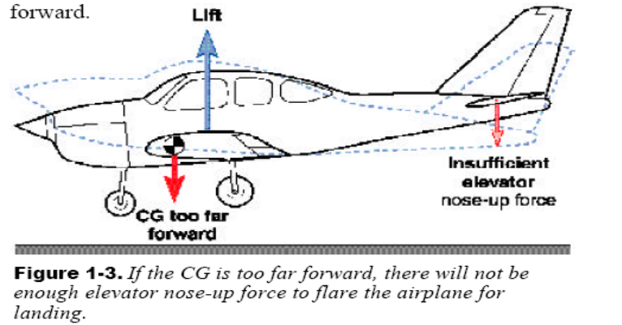
Unstable Aircraft
Aircraft with too much stability
Notes:
An aircraft’s stability is determined by the relationship between the center of gravity and the aerodynamic center.

Slide 26
A more amusing example of failure to properly manage center of gravity
(although it could easily have been tragic….)

Slide 27
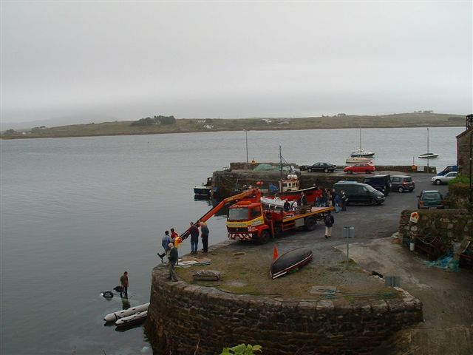

Slide 28
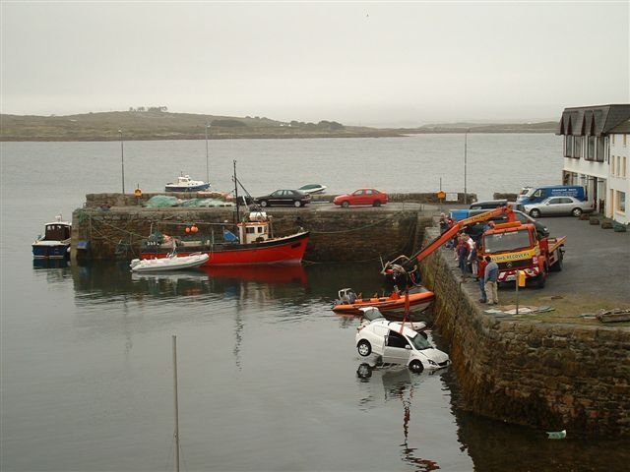

Slide 29
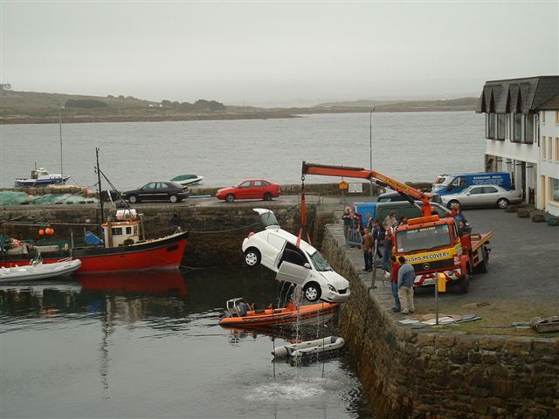

Slide 30
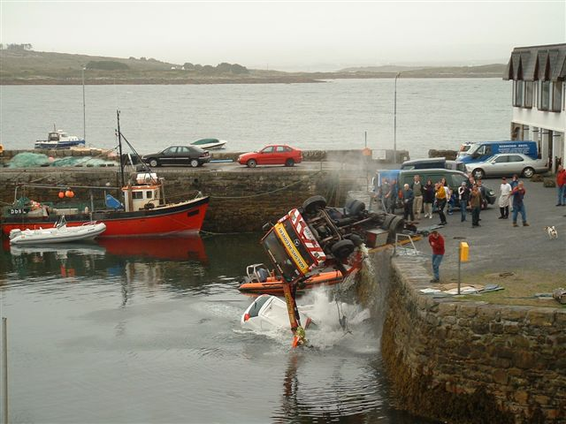

Slide 31
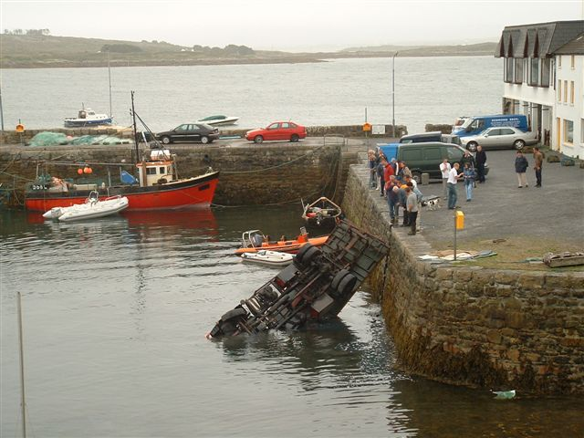

Slide 32
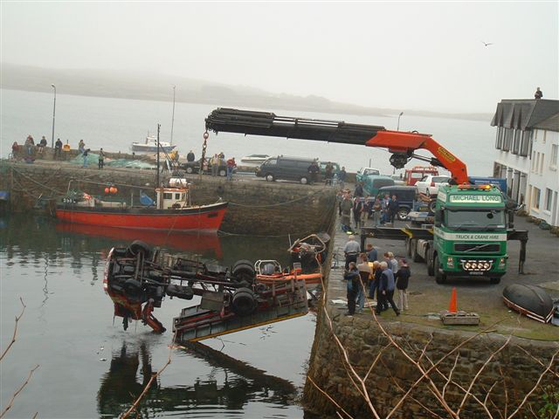

Slide 33
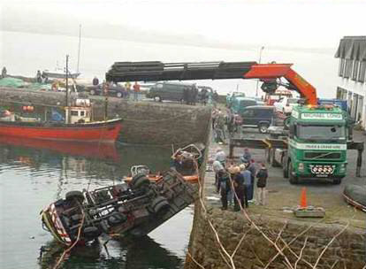

Slide 34
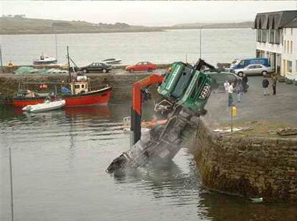

Slide 35
Any Questions ?

